Slide 1

Artify AI
By: Claudio Sandrio, Francis Bolay, Magaly Guillen
Notes:
Introduction: Have you ever been coloring and been tired of limiting your creativity? Introducing Artify AI

Slide 2

What is TAP?
Technology Ambassadors Program
An award-winning program dedicated to boosting student interest in computing through numerous outreach activities led by students at Georgia Gwinnett College. TAP faculty and students wanted to increase curiosity and enthusiasm in technology through interactive workshops in introductory ITEC classes at Georgia Gwinnett College and extracurricular activities for K-12 student

Slide 3
Goals
Objective: We aim to encourage students to acknowledge and embrace technologies throughout the rest of their lives. More specifically teach the practical and creative side of AI and technology
Motivation : We believe this study will motivate students to use technology with responsibility and understand the impact AI had on society and individual people.

Slide 4
Things We Should Learn Today
How AI can understand context and learns from data.
How to embrace creativity with AI.
How AI and Programming can be used together.
How do to construct a prompt to return desired result
How to safely use AI.

Slide 5

What is AI?
Artificial Intelligence
a set of technologies that allow computers to perform tasks that typically require human intelligence
It can get smarter over time by practicing or looking at new information, so it can do things like recognize pictures, talk to us, or help us solve problems.

Slide 6

How AI Learns?
Improves over time and learns from mistakes
Gets data
Recognizes patterns
Makes predictions
Example Chess Game:
1.AI is shown how pieces move in chess and past strategies used to play.
2.Recognizes which strategies most often lead to victory based on opponents move
3.AI will predict which next move will lead to victory
4.After each game whether it wins or loses feedback is received. Then for the next game a new strategy is implemented.

Slide 7
AI Ethics
Be kind and Honest
Privacy
Responsibility
Understanding Bias
Protect your online privacy by keeping that private information safe
AI can be a great tool but you should understand its strengths and limits, and not just rely on it for everything.
AI can sometimes make mistakes if it's trained with wrong or unfair information.
AI is designed to help people in positive ways, not cause harm or spread false information.

Slide 8
Daily Use of AI
Gaming- AI is used to match players with the correct level opponent to ensure the game is fun and challenging
Voice Assistants- ex. Siri, Alexa, and Google assistant
Search Engines- Based on the input AI understands the questions and returns the most relevant information
Navigation Apps- Suggests the quickest route and provides information about traffic flow
Social Media- Facebook, Instagram, and TikTok use AI to decide which posts, photos, or videos you see based on your interests

Slide 9

AI in Artify
Implemented to allow participants to use their creativity to produce their desired templates.

Slide 10

Programming

Slide 11
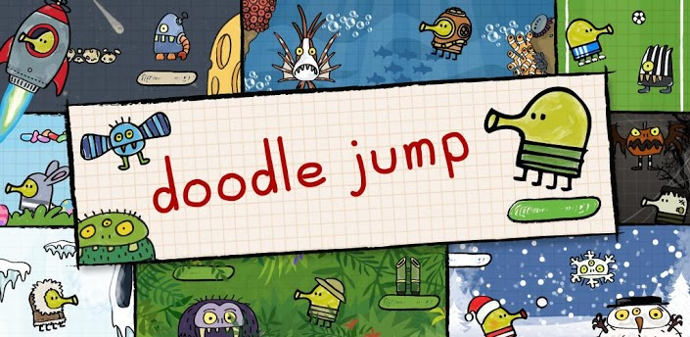
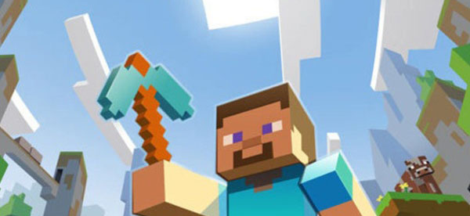
Coding in Artify
How we made Artify AI was through Java Processing.
Processing is an open-source programming environment and language based on Java, designed to simplify the creation of visual art, graphics, and interactive projects, making it accessible to artists and beginners.
Examples of popular games that used Java Processing.

Slide 12
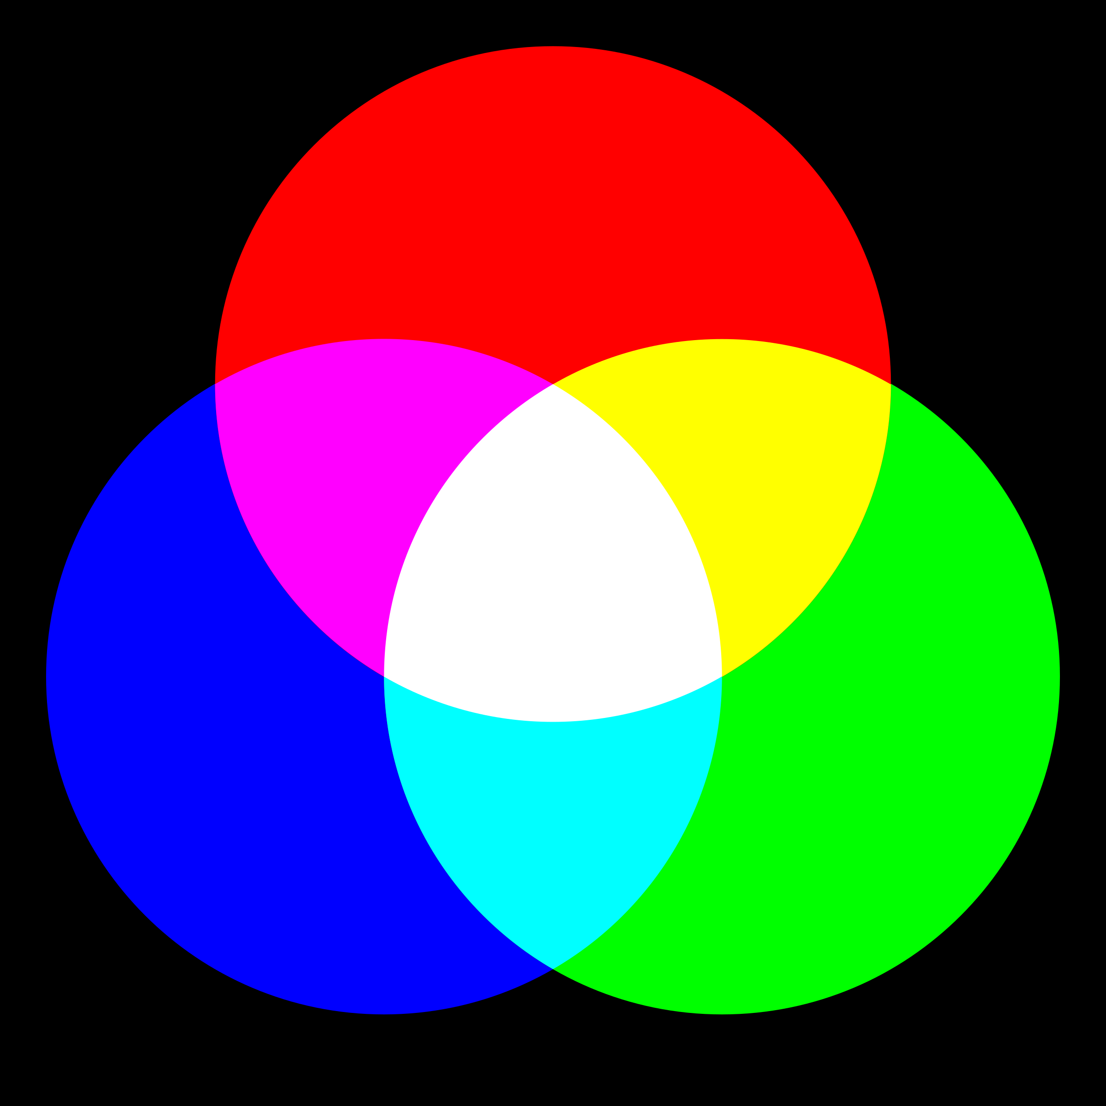
RBG
stands for Red, Green, Blue, which are the primary colors of light used in digital imaging and displays.
(Red, Green, Blue)
(255,0,0) = Red
Colors made with RGB
(255,255,255) = White, all colors at max
(0,255,0) = Green
(0,0,255) = Blue
(0,0,0)= Black, no color

Slide 13
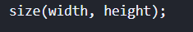
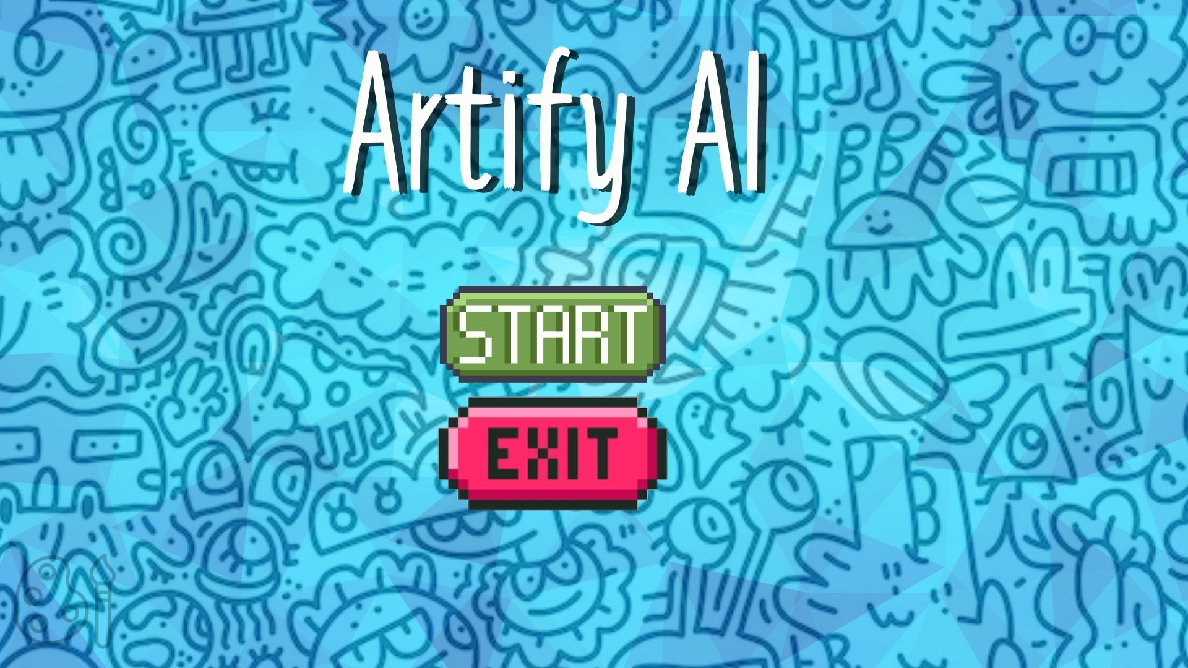
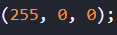
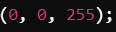
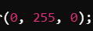
Basic Functions We Used
Sneak peak of how we coded Artify AI.
background(220)` makes the background of your drawing white. The number 220 is like the "color code" for white, and it helps clear the screen before you draw anything new.
The size() function is used to set the dimensions of the display window.
Function is used to set the color used to fill shapes.
Three values representing the red, green, and blue components of the color (0-255 each).
RED
BLUE
GREEN

Slide 14
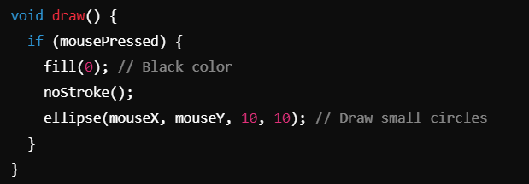
Continued.
How You Are Able To Draw.
draw() → Runs continuously to update the screen.
If (mouse Pressed) → Checks if the mouse is being pressed.
fill(0); → Sets the color to black (0 in grayscale)
noStroke(); → Removes outlines from the shapes.
ellipse(mouseX, mouseY, 10, 10); → Draws a small circle at the mouse position.
When you press the mouse, this code draws a small black circle wherever the mouse is on the screen, and it doesn't have a border around it. It keeps doing this as long as the mouse button is held down.

Slide 15
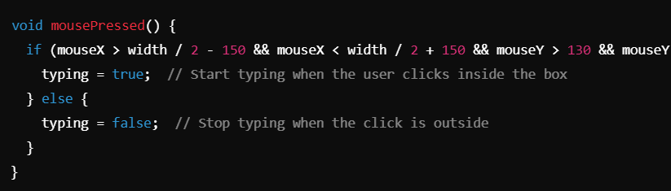
Continued.
This is how we set up the typing indicator for you guys to type in what you want to draw.
The if condition checks whether the mouse is within the horizontal and vertical bounds of the input box.
If the mouse is inside, it sets typing = true (allowing the user to type).
If the mouse is outside, it sets typing = false (disabling typing).

Slide 16

Trivia Time

Slide 17
Trivia
1. Why is AI important for the future?

Slide 18
Trivia
2. How does AI learn new things?
By memorizing all the data it’s given and never adjusting.
B) By collecting data, training on it using algorithms, creating models, and adjusting based on feedback. C) By following a set of pre-programmed rules without any need for data or training. D) By instantly knowing everything once it's turned on and never needing any feedback.
Correct Answer: B) By collecting data, training on it using algorithms, creating models, and adjusting based on feedback.

Slide 19
Trivia
3. What are some examples of AI that you use daily?

Slide 20
Trivia
4. What do the three values in the fill(r, g, b) function represent?
A) The size of the shapes.
B) The red, green, and blue color components (0-255) for the shape’s color.
C) The position of the shapes on the screen.
D) The speed of drawing the shapes.

Slide 21

Coloring Book Example

